Slide 1
Manson Trojans
PRIDE * PASSION * GRIT
Class of 2023
Update

Slide 2
Spring Calendar
May 20: Hang Banners Downtown
May 23 and 25: Senior Presentations 6:30pm at MHS
June 6: Senior Awards 6:30pm Manson High School
June 7, 8: Senior Trip to Silverwood
June 9: Grad practice and BBQ
June 10: Graduation Ceremony 2:30pm Manson High School

Slide 3
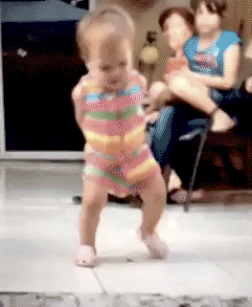
State of the Seniors
Progress on CREDITS for graduation
43 on track to graduate on time
2 behind but making good progress
2 will not make it

Slide 4
State of the Seniors
Pathway Requirements Met
Dual Credit (math and ELA) | CTE
29 | 13
4 students still working towards pathway requirement
High School and Beyond Plan: Final meeting and check during conferences
14 students have already earned the Seal of Biliteracy

